Slide 1
Microservice Communication Types
Programming Palli

Slide 2
Introduction to Microservice Communication
Monolithic application is divided into these smaller modules.
One common question - how should they be effectively interconnected?
There isn’t a definitive answer to this question.
Several approaches can be considered based on the specific application.

Slide 3
Microservice Communication Types
There are three microservice communication types:
Request-Driven Architecture.
Event-Driven Architecture.
Hybrid Architecture.

Slide 4
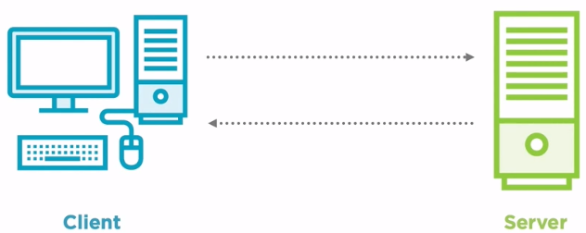
Request-Driven Architecture
It is synchronous communication.
The client sends a request to the server and expects a response.
Services communicate using HTTP or GRPC.
Easier to debug and troubleshoot.
If one of the dependent services is down, there is a high chance to exclude calls to the other services.

Slide 5
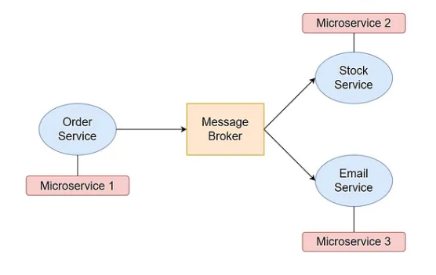
Event-Driven Architecture
This communication type microservices dont call each other.
Service created events and consume events from message broker systems in an async way.
The system becomes highly scalable and distributed.
Guaranteed delivery.
Adding new consumers is easy.
Debug and troubleshoot are challenaging.

Slide 6
Hybrid Architecture.
Combine synchronous and asynchronous patterns depending on your custom scenario.
Request-Driven Architecture: Basket and Discount with gRPC calls.
Event-Driven Architecture: Basket checkout event between Basket and Ordering microservices.

Slide 7
Question?

Slide 8
Thank You
Please subscribe

